Slide 1



LET’S CODE TOGETHER!

Slide 2

Established since February 20, 1991

Slide 3
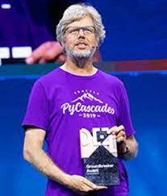
GUIDO VAN ROSSUM
Distinguished Engineer in the Developer Division at Microsoft
(since November 2020) Creator of the Python Programming Language

Slide 4
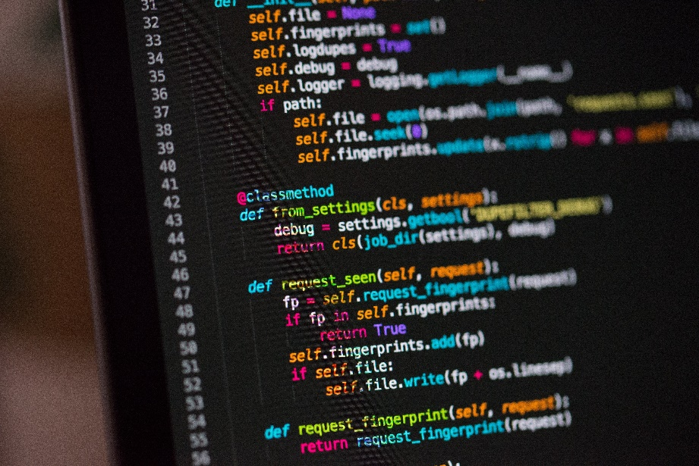


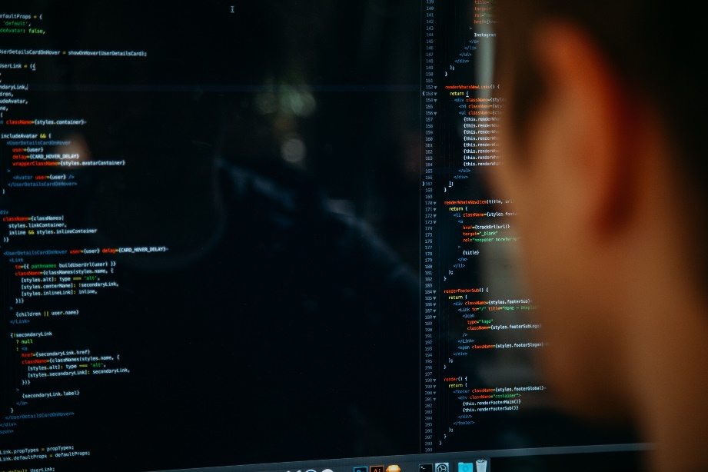
Python is used for:

Slide 5

What can python do?

Slide 6

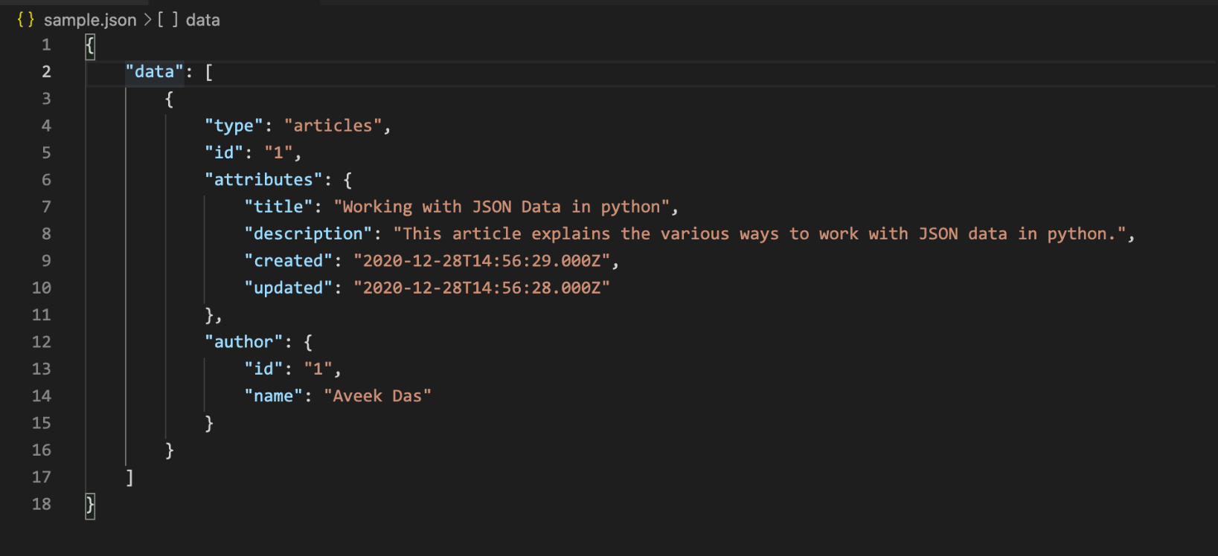
What can python do?

Slide 7
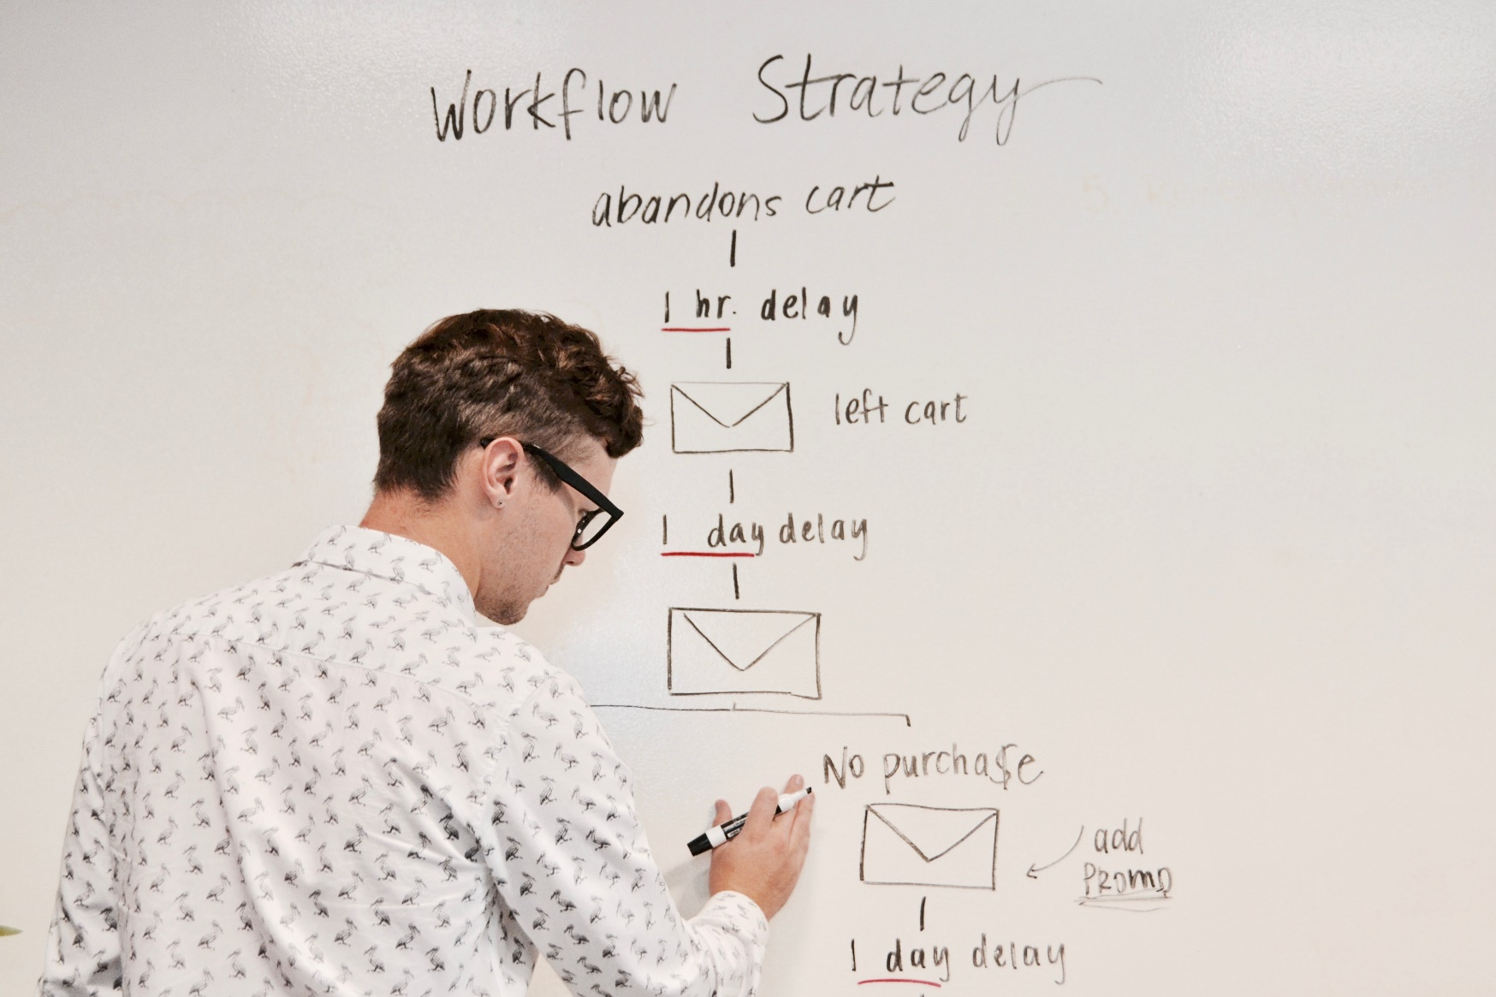
What can python do?

Slide 8

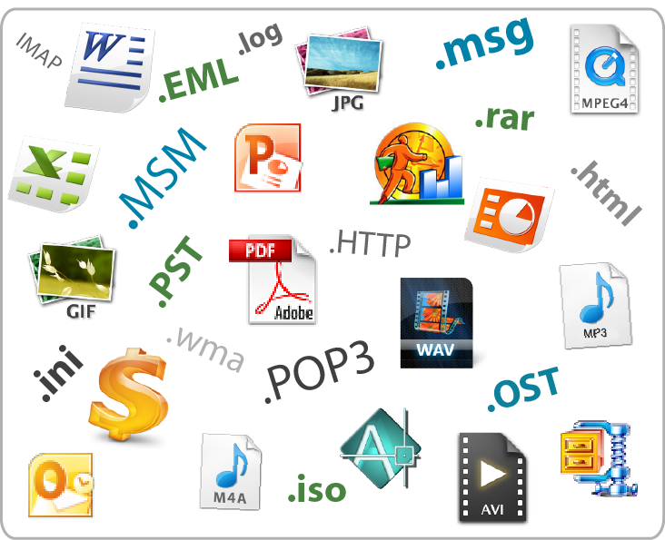
What can python do?

Slide 9
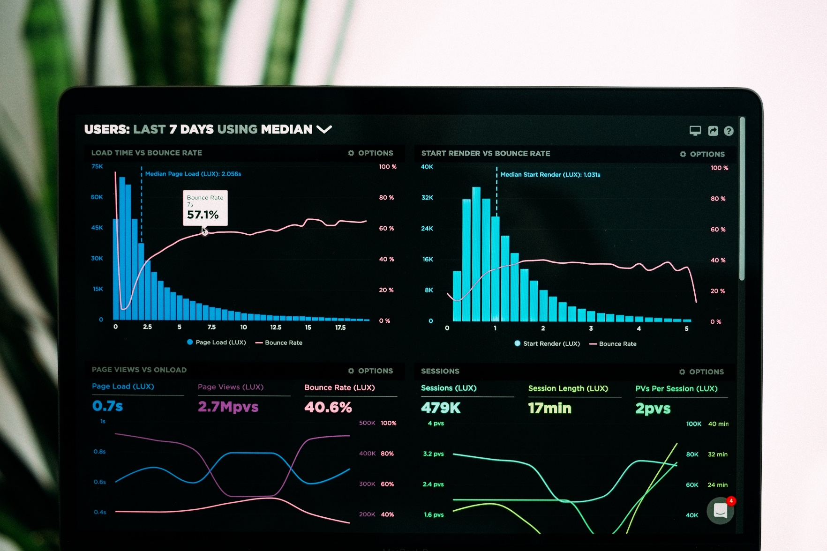
What can python do?

Slide 10

What can python do?

Slide 11
WhY CHOOSE PYTHON?

Slide 12




WhY CHOOSE PYTHON?

Slide 13
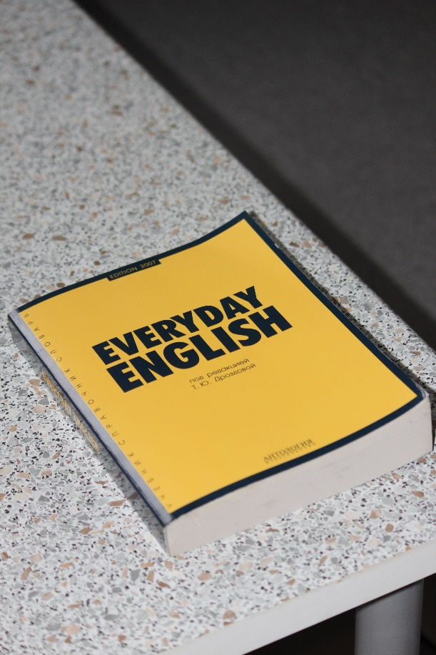
WhY CHOOSE PYTHON?

Slide 14
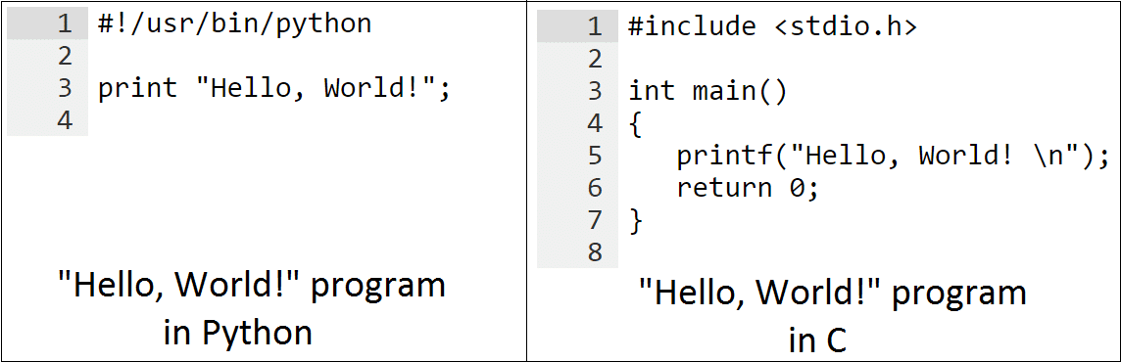
WhY CHOOSE PYTHON?

Slide 15
INTERPRETER (NOUN)
WhY CHOOSE PYTHON?
a computer program that is used to directly execute program instructions written using one of the many high-level programming languages
transforms the high-level program into an intermediate language that it then executes, or it could parse the high-level source code and then performs the commands directly, which is done line by line or statement by statement
(Source: https://www.techopedia.com/definition/7793/interpreter)

Slide 16
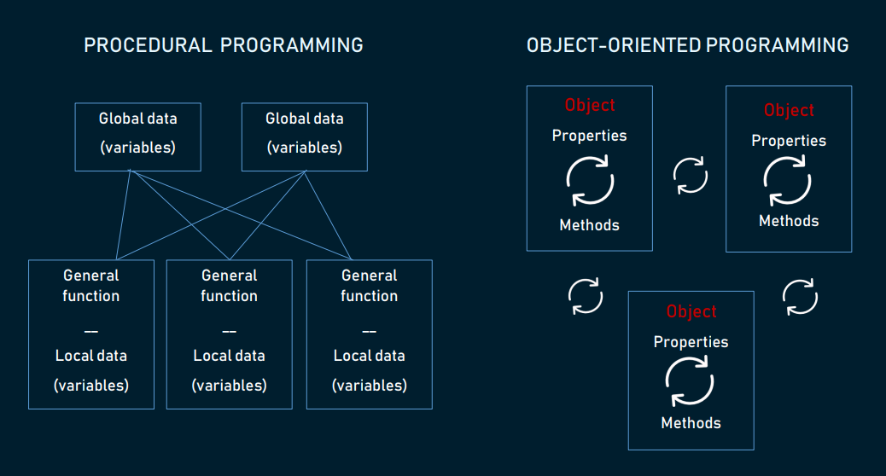
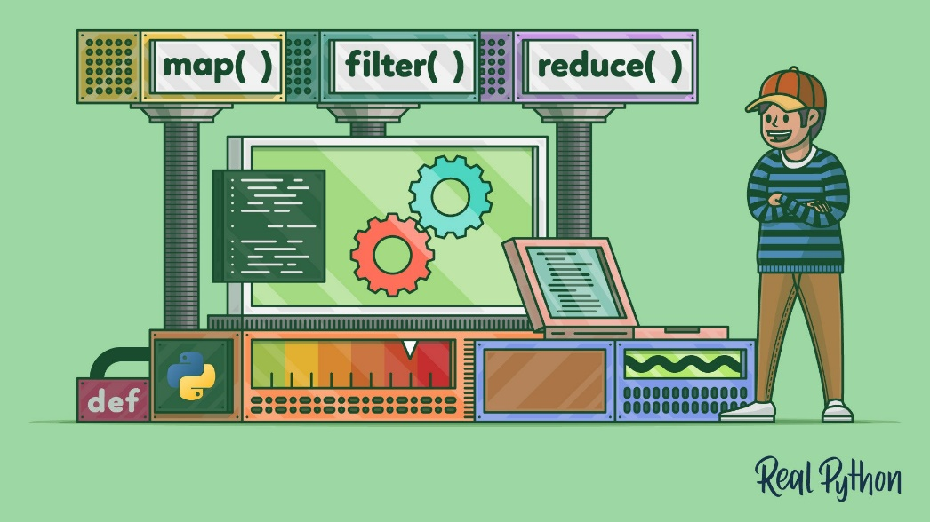
WhY CHOOSE PYTHON?

Slide 17
What MAKES python different?

Slide 18
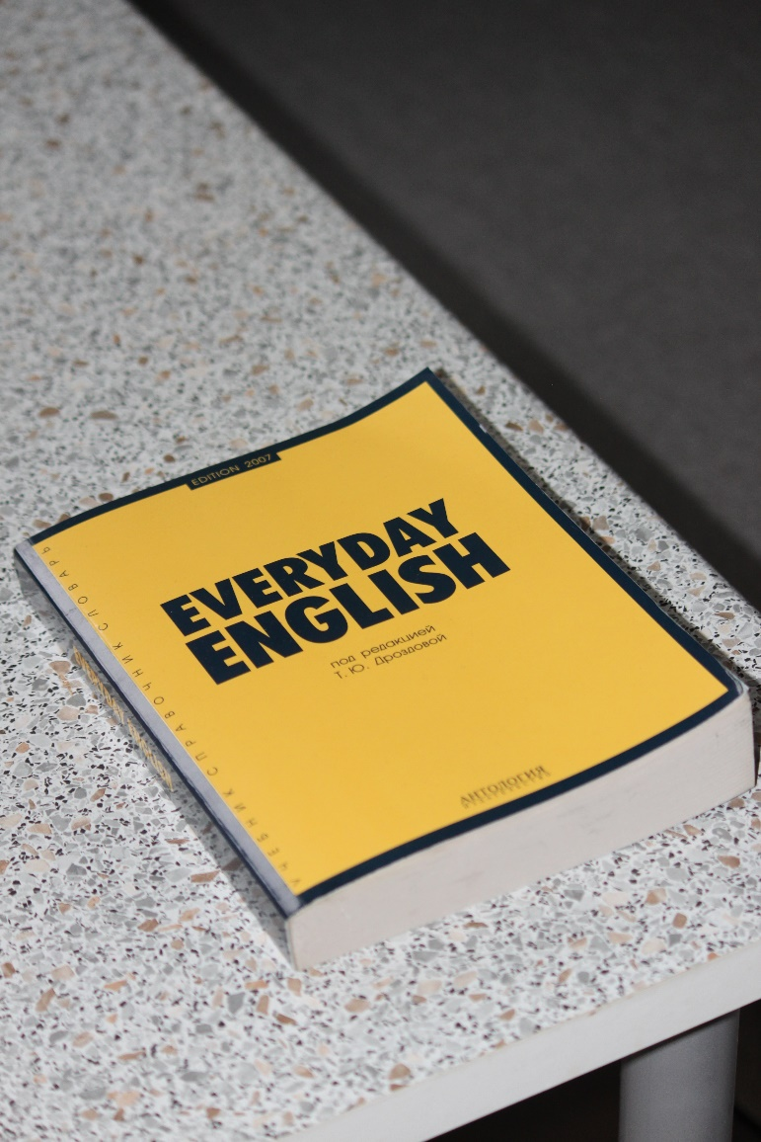
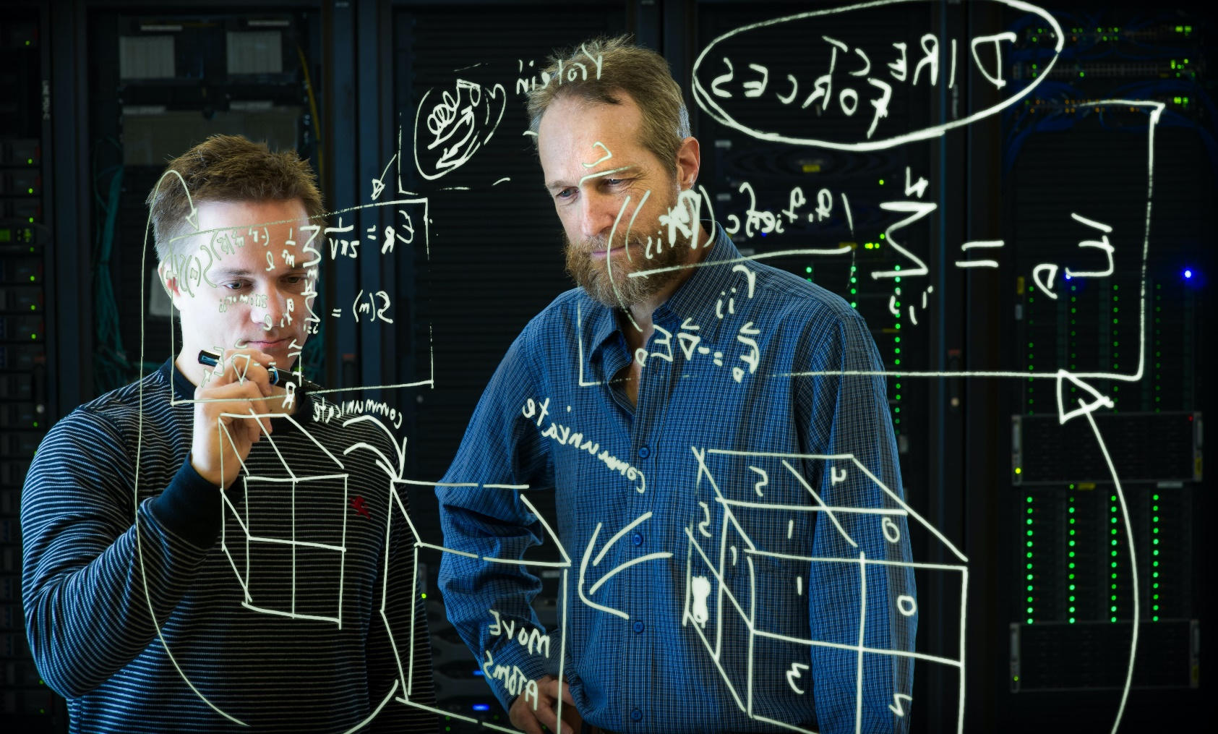
What MAKES python different?

Slide 19
What MAKES python different?
\n
“We rely on this to complete a command. No need for semicolons! (Please refer to the Enter key.)” - Python Programming Language

Slide 20
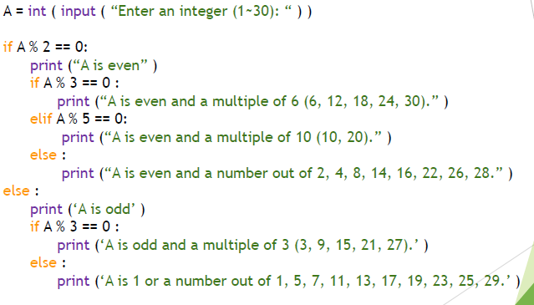
What MAKES python different?

Slide 21



Slide 22
PYTHON 3 SYLLABUS
Python Syntax
Indentations
Comments
Variables
Casting
Numbers
Strings
Booleans
Arithmetic Operators
Assignment Operators
Comparison Operators
Logical Operators
Membership Operators
if statement
elif statement
else statement
Lists
Dictionaries
while loop
for loop
Functions
Classes & Objects
Inheritance
Sets
Tuples
Math
String Formatting
f strings
Lambdas
Iterators
Scope
JSON
User Input
Try…Except

Slide 23
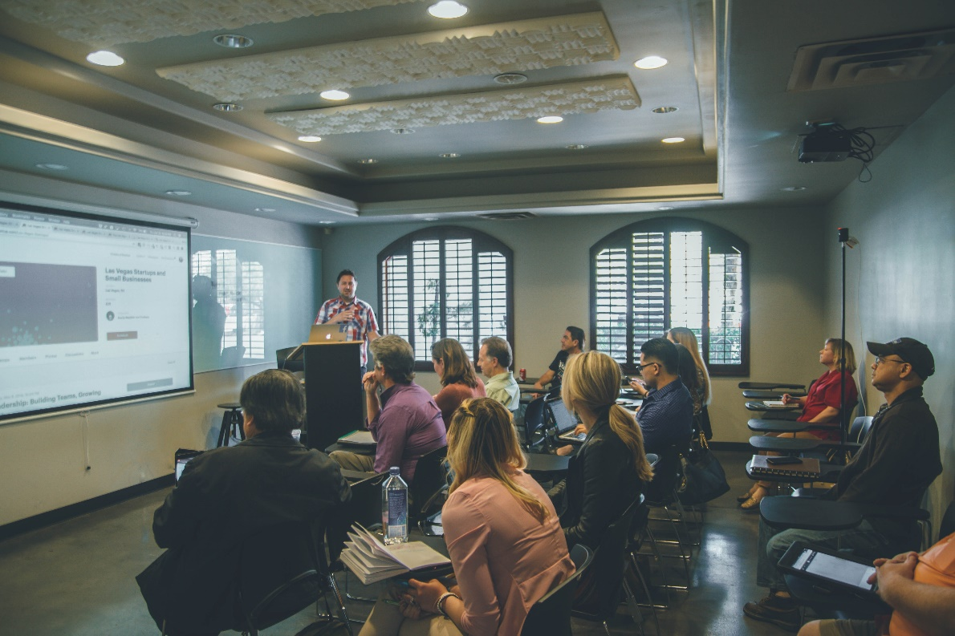
MORE SOURCES FOR LEARNING PYTHON
Your teachers/instructors/professors and the Dean

Slide 24

MORE SOURCES FOR LEARNING PYTHON
Your fellow students, programmers or developers who are your seniors/experts, associates and juniors

Slide 25

MORE SOURCES FOR LEARNING PYTHON
GC CCS Developers’ Guild (https://www.facebook.com/groups/1134279733274369)

Slide 26

MORE SOURCES FOR LEARNING PYTHON
LinkedIn (https://www.linkedin.com/)

Slide 27

MORE SOURCES FOR LEARNING PYTHON
Facebook (https://www.facebook.com/)

Slide 28

MORE SOURCES FOR LEARNING PYTHON
Python Documentation (https://docs.python.org/3/)
Stable Version: 3.9.7

Slide 29

MORE SOURCES FOR LEARNING PYTHON
W3Schools (https://www.w3schools.com/python/default.asp)

Slide 30

MORE SOURCES FOR LEARNING PYTHON
Tutorials Point (https://www.tutorialspoint.com/python/index.htm)

Slide 31

MORE SOURCES FOR LEARNING PYTHON
Programiz (https://www.programiz.com/python-programming)

Slide 32

MORE SOURCES FOR LEARNING PYTHON
Udemy (https://www.udemy.com/)

Slide 33

MORE SOURCES FOR LEARNING PYTHON
SoloLearn (https://www.sololearn.com/home)

Slide 34

MORE SOURCES FOR LEARNING PYTHON
Stack Overflow (https://stackoverflow.com/)

Slide 35

“I have the strength to face all conditions by the power that Christ gives me.”
Philippians 4:13 (Good News Translation)

Slide 36
SOURCES
https://gvanrossum.github.io/
https://pythoninstitute.org/what-is-python/#:~:text=Python%20is%20a%20widely%2Dused,released%20on%20February%2020%2C%201991.
https://unsplash.com/
https://www.techopedia.com/definition/7793/interpreter
https://www.w3schools.com/python/default.asp

